Slide 1
Radio Wave Propagation:
Getting from Point A to Point B
Radio waves propagate by many mechanisms.
  The science of wave propagation has many facets.
We will discuss three basic ways:
  Line of sight
  Ground wave
  Sky wave

Slide 2
Line-of-Sight
If a source of radio energy can been seen by the receiver, then the radio energy will travel in a straight line from transmitter to receiver.
  There is some attenuation of the signal as the radio wave travels
This is the primary propagation mode for VHF and UHF signals.
Notes:
Line-of-sight is probably the easiest propagation mode for students to understand. You can use a laser pointer to demonstrate line-of-sight. You will probably have to refresh the students memory on UHF and VHF definitions and their position on the RF spectrum. Also these bands will be the primary operating bands of the new hams.
The maximum distance for line-of-sight transmissions with two people standing on the surface of the earth is about (roughly) 25 miles, this is due to the curvature of the earth. You can extend this discussion by briefly brining up repeaters and how they extend the line-of-sight range.

Slide 3
Ground Wave
Some radio frequency ranges (lower HF frequencies) will hug the earth’s surface as they travel
These waves will travel beyond the range of line-of-sight
A few hundred miles
Notes:
Point out that this propagation mode is the one used by AM broadcast stations in the day light hours. You can connect with the students experiences with receiving AM broadcast stations using ground waves. What happens at night? Why do they change power levels depending on the time of day? How is the reception at night?

Slide 4
VHF and UHF Propagation
VHF & UHF propagation is principally line of sight.
Range is slightly better than visual line of sight.
UHF signals may work better inside buildings because of the shorter wavelength.
Buildings may block line of sight, but reflections may help get past obstructions.
Reflections from a transmitter that is moving cause multi-path which results in rapid fading of signal – known as picket fencing.
Notes:
Line-of-sight is probably the easiest propagation mode for students to understand. You can use a laser pointer to demonstrate line-of-sight. You will probably have to refresh the students memory on UHF and VHF definitions and their position on the RF spectrum. Also these bands will be the primary operating bands of the new hams.
The maximum distance for line-of-sight transmissions with two people standing on the surface of the earth is about (roughly) 25 miles, this is due to the curvature of the earth. You can extend this discussion by briefly brining up repeaters and how they extend the line-of-sight range.

Slide 5
Sunspot Cycle
The level of ionization depends on the radiation intensity of the Sun.
Radiation from the Sun is connected to the number of sunspots on the Sun’s surface.
  High number of sunspots, high ionizing radiation emitted from the Sun.
Sunspot activity follows an 11-year cycle.
Notes:
Here is a good place to discuss the sun spot cycle, some of the students might make the connection between this practical application of science and the study of the sun and to some things they have heard about sun spots on the evening news programs.

Slide 6
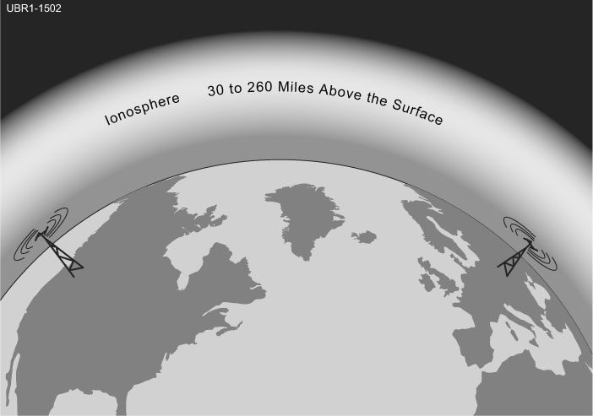
Ionosphere
Radiation from the Sun momentarily will strip electrons away from the parent atom in the upper reaches of the atmosphere.
  Creates ions
The region where ionization occurs is called the ionosphere.
Notes:
Discuss with the students what happens to ionize the upper reaches of the atmosphere. You may have to tap into some old science lessons and vocabulary that the students haven’t thought about in years. Define what an Ion is.
The concept of momentarily stripping away the electrons is important when you get into the details of the layers of the ionosphere and the time it takes for the ionosphere to dissipate during the evening and night time hours.
You can also refer back to the students experience with AM broadcasts and what they observe at night versus what they observe during the day time.

Slide 7
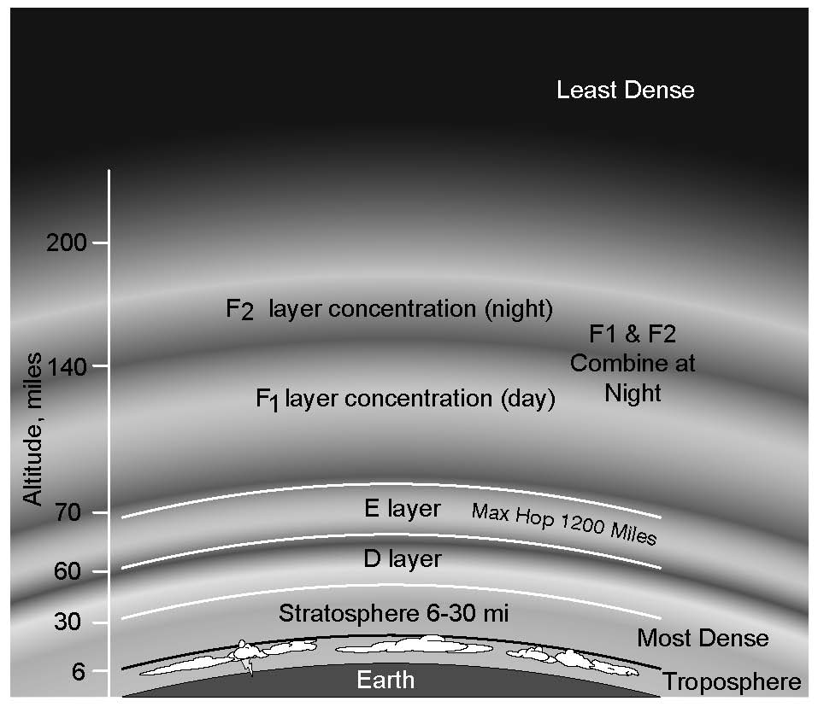
Levels of the Ionosphere
Density of the atmosphere affects:
  The intensity of the radiation that can penetrate to that level.
  The amount of ionization that occurs.
  How quickly the electrons recombine with the nucleus.

Slide 8
The Ionosphere – An RF Mirror
The ionized layers of the atmosphere actually act as an RF mirror that reflect certain frequencies back to earth.
Sky-wave propagation is responsible for most long-range, over the horizon communication.
Reflection depends on frequency and angle of incidence.
Notes:
If the angle is too steep, the waves go right through. If the frequencies are too low or too high, they also are not reflected, and in some cases are absorbed by the layer. Constant monitoring of the ionosphere indicates the maximum and minimum usable frequencies for sky-wave propagation. Hams interested in DX (you might have to explain DX) will adjust their operating bands to take advantage of those frequencies that are reflected off the ionosphere.

Slide 9

What should you do if another operator reports that your station’s 2 meter signals were strong just a moment ago, but now they are weak or distorted?
A. Change the batteries in your radio to a different type
B. Turn on the CTCSS tone
C. Ask the other operator to adjust his squelch control
D. Try moving a few feet, as random reflections may be causing multi-path distortion

Slide 10
Why are UHF signals often more effective from inside buildings than VHF signals.
A. VHF signals lose power faster over distance
B. The shorter wavelength allows them to more easily penetrate the structure of buildings
C. This is incorrect: VHF works better than UHF inside buildings
D. UHF antennas are more efficient than VHF antennas

Slide 11

What term is commonly used to describe the rapid fluttering sound sometimes heard from mobile stations that are moving while transmitting?
A. Flip-flopping
B. Picket fencing
C. Frequency shifting
D. Pulsing

Slide 12
What is the cause of irregular fading of signals from distant stations during times of generally good reception?
A. Absorption of signals by the “D” layer of the ionosphere
B. Absorption of signals by the “E” layer of the ionosphere
C. Random combining of signals arriving via different path lengths
D. Inter-modulation distortion in the local receiver

Slide 13

What may occur if VHF or UHF data signals propagate over multiple paths?
A. Transmission rates can be increased by a factor equal to the number of separate paths observed
B. Transmission rates must be decreased by a factor equal to the number of separate paths observed
C. No significant changes will occur if the signals are transmitting using FM
D. Error rates are likely to increase

Slide 14
Which part of the atmosphere enables the propagation of radio signals around the world?
A. The stratosphere
B. The troposphere
C. The ionosphere
D. The magnetosphere

Slide 15
Why are “direct” (not via a repeater) UHF signals rarely heard from stations outside your local coverage area?
A. They are too weak to go very far
B. FCC regulations prohibit them from going more than 50 miles
C. UHF signals are usually not reflected by the ionosphere
D. They collide with trees and shrubbery and fade out

Slide 16
Which of the following might be happening when VHF signals are being received from long distances?
A. Signals are being reflected from outer space
B. Signals are arriving by sub-surface ducting
C. Signals are being reflected by lightning storms in your area
D. Signals are being refracted from a sporadic E layer

Slide 17
What is a characteristic of VHF signals received via auroral reflection?
A. Signals from distances of 10,000 or more miles are common
B. The signals exhibit rapid fluctuations of strength and often sound distorted
C. These types of signals occur only during winter nighttime hours
D. These types of signals are generally strongest when your antenna is aimed to the south (for stations in the Northern Hemisphere)

Slide 18
Which of the following propagation types is most commonly associated with occasional strong over-the-horizon signals on the 10, 6, and 2 meter bands?
A. Backscatter
B. Sporadic E
C. D layer absorption
D. Gray-line propagation

Slide 19
What is meant by the term “knife-edge” propagation?
A. Signals are reflected back toward the originating station at acute angles
B. Signals are sliced into several discrete beams and arrive via different paths
C. Signals are partially refracted around solid objects exhibiting sharp edges
D. Signals are propagated close to the band edge exhibiting a sharp cutoff

Slide 20
What band is best suited to communicating via meteor scatter?
A. 10 meters
B. 6 meters
C. 2 meters
D. 70 cm

Slide 21
What causes “tropospheric ducting?”
A. Discharges of lightning during electrical storms
B. Sunspots and solar flares
C. Updrafts from hurricanes and tornados
D. Temperature inversions in the atmosphere

Slide 22
What is generally the best time for long-distance 10 meter band propagation?
A. During daylight hours
B. During nighttime hours
C. When there are coronal mass ejections
D. Whenever the solar flux is low

Slide 23
What is the radio horizon?
A. The distance at which radio signals between two points are effectively blocked by the curvature of the earth
B. The distance from the ground to a horizontally mounted antenna
C. The farthest point you can see when standing at the base of your antenna tower
D. The shortest distance between two points on the Earth’s surface

Slide 24
Why do VHF and UHF radio signals usually travel somewhat farther than the visual line of sight distance between two stations?
A. Radio signals move somewhat faster than the speed of light
B. Radio waves are not blocked by dust particles
C. The Earth seems less curved to radio waves than to light
D. Radio waves are blocked by dust particles

